Slide 1
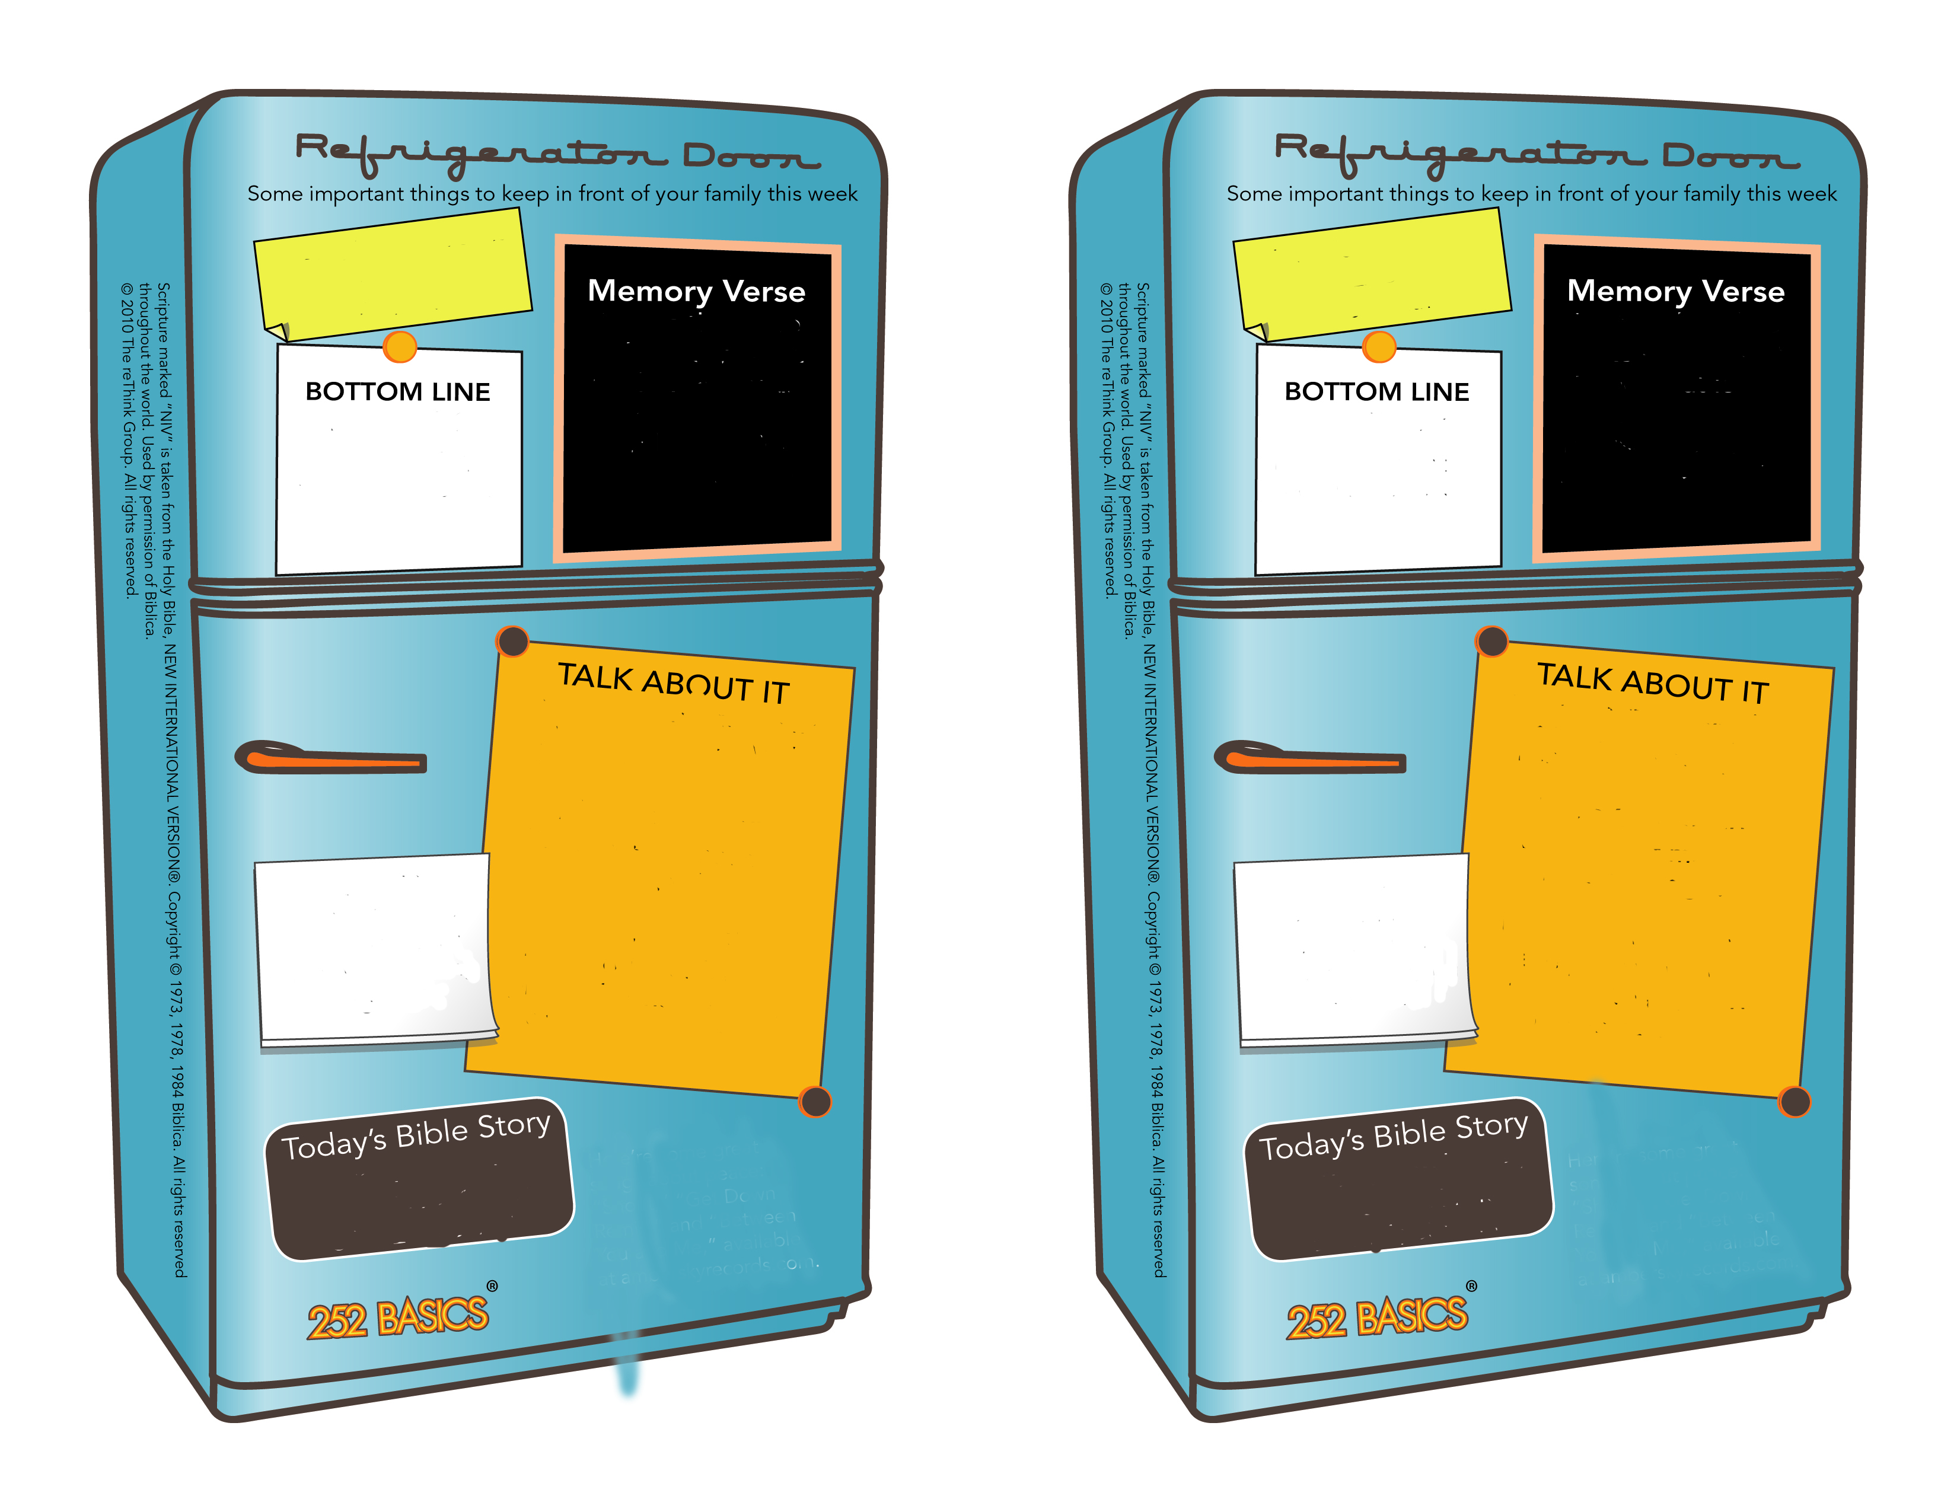
Kindness - Showing others they are valuable by how you treat them.
“Do to others as you want them to do to you.”
Luke 6:31, NIrV
Kindness - Showing others they are valuable by how you treat them
“Do to others as you want them to do to you.”
Luke 6:31, NIrV
Be kind to your family and friends.
Be kind to your family and friends.
Ask a kid: What is something you might have to sacrifice to show kindness to someone else?
Ask a parent: What act of kindness by someone else inspired you to be kind?
Ask a kid: What is something you might have to sacrifice to show kindness to someone else?
Ask a parent: What act of kindness by someone else inspired you to be kind?
Check out the activity on the back of this card. If you like what you see, check out: crosspointweb.org/kids/
Check out the activity on the back of this card. If you like what you see, check out: crosspointweb.org/kids/
Ruth and Boaz
Ruth 1 & 2
Ruth and Boaz
Ruth 1 & 2
February
Week 2
February
Week 2

